Slide 1
Find hospitals in Pandemic Situation
Rahul Pratap Singh

Slide 2
INtroducton
This project aims at finding hospitals to tackle a pandemic situation. In case a widespread deadly disease spread, then we have to respond quickly. A quicker response can save us from the pandemic. The first thing will be finding the infected ones and next, to diagnose them. The best possible option is to find and help hospitals in the area, but for a densely populated city like New York, Tokyo, and Paris, this won't be an easy job. Hence, here I will be using Data Science and Machine Learning to locate the hospitals and analyze it to check whether it can serve the purpose. In this pandemic, this projects aims to find out all possible

Slide 3
Business Problem
To gather locations of Hospitals and to locate them using FOURSQUARE, plot it with the population of the city. Analyzing data to find out insides on medical preparation for a pandemic.

Slide 4
Target Audience
This project is for governments who have to tackle the situation of an outbreak, Health Ministry and Medical heads.

Slide 5
Data
Using FOURSQUARE for searching hospitals and their locations.
Using this data to plot it on Map.
Clustering them to know the groups of location for better connectivity.
Taking insights about population from Wikipedia.
Using population data to check the sufficiency of hospitals.

Slide 6
Methodlogy
Data was collected from Foursquare. Then plotted on the Map to viusalize thier position
Then, clustered through DBSCAN, based on thier distance hence creating a density remark from the center of city.
It was labelled in such a way that two nearest hospitals are red, distance more than that blue, green and brown for the far one.
I plotted the population too which gives us the notion of required medical facilities.

Slide 7
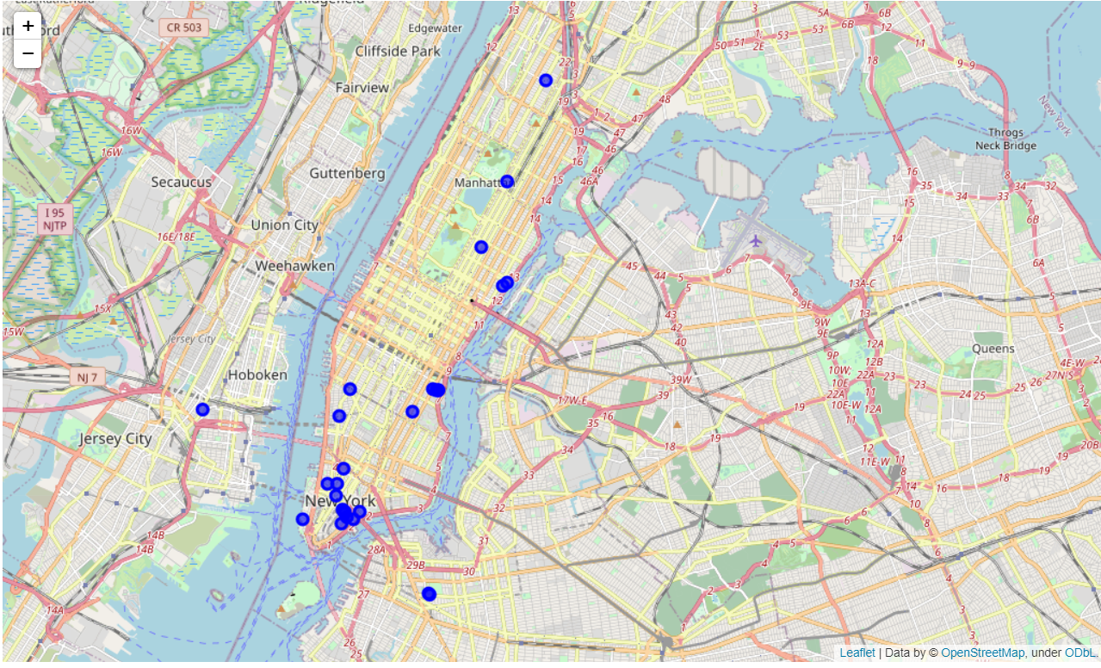
New York
Hospitals in New York under 40 Km radius. Plotted Data.

Slide 8
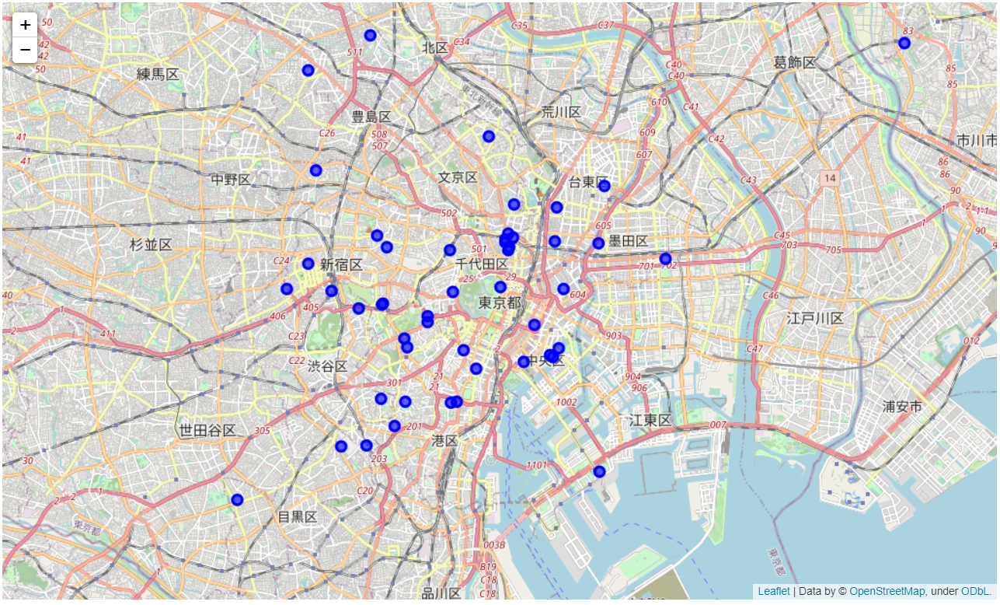
Tokyo
Hospitals in New York under 40 Km radius. Plotted Data.

Slide 9
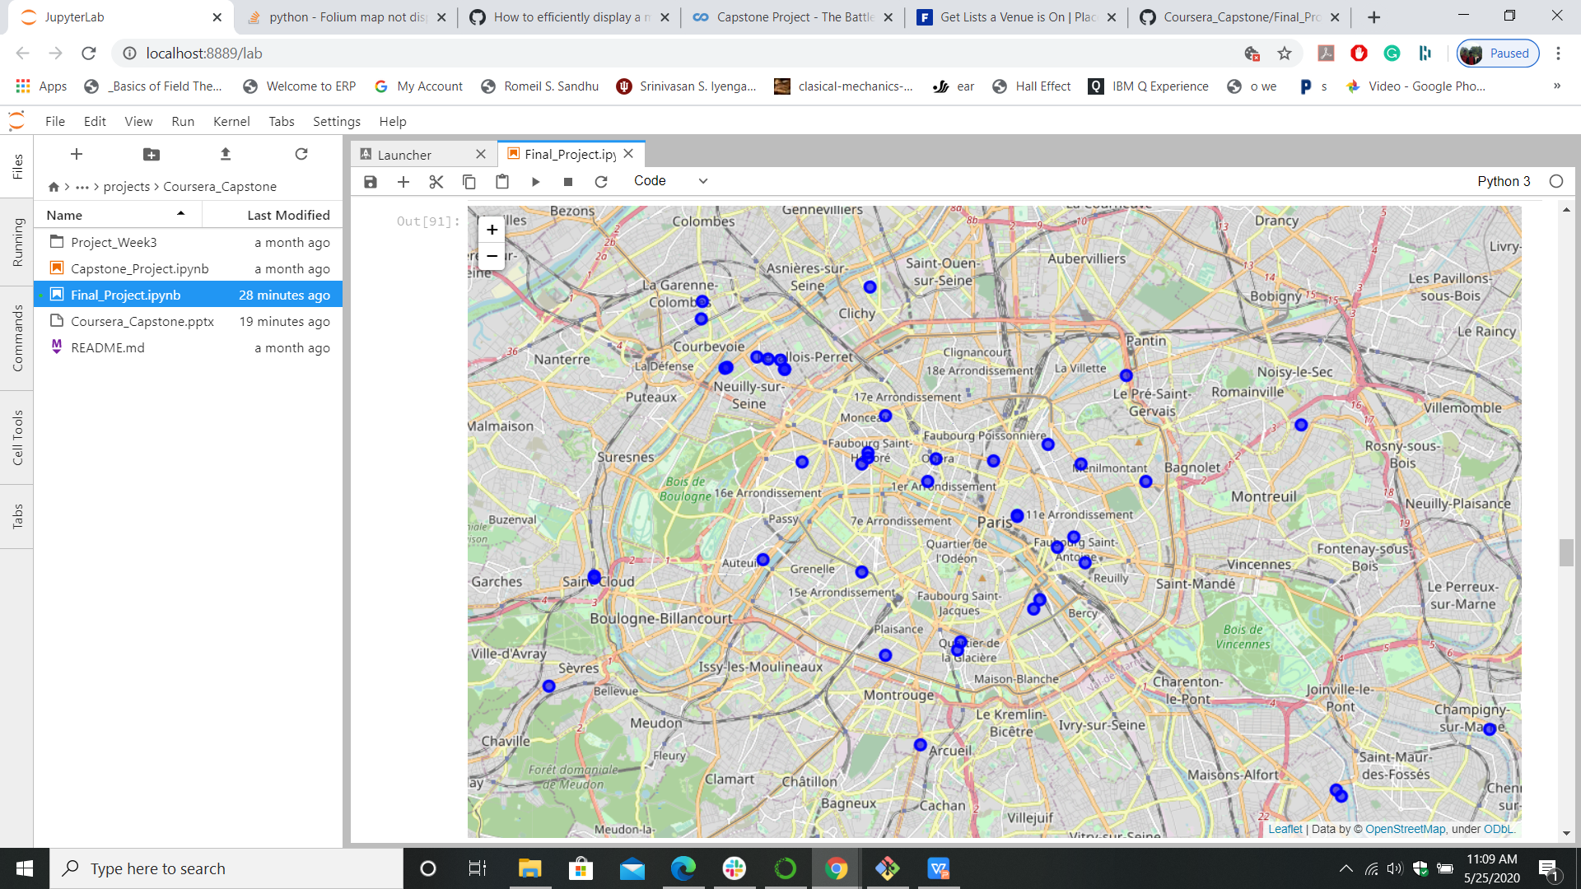
Paris
Hospitals in New York under 40 Km radius. Plotted Data.

Slide 10
Clustering
The data was clustered after that using DBSCAN, the parameter for clustering was distance from the center of city as located by geocoder.
Brown's ones are far located, red one as nearest then blue and green

Slide 11
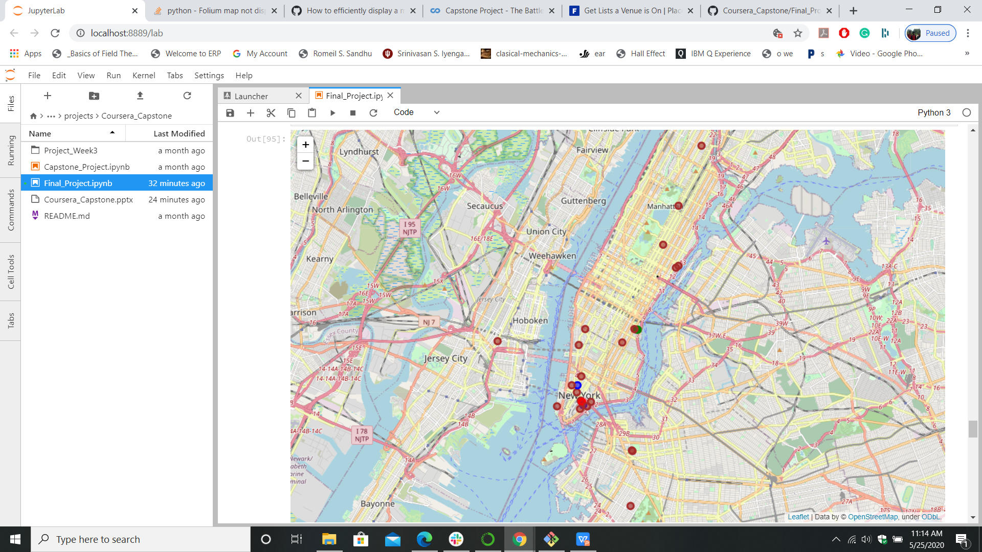
Clustered New York

Slide 12
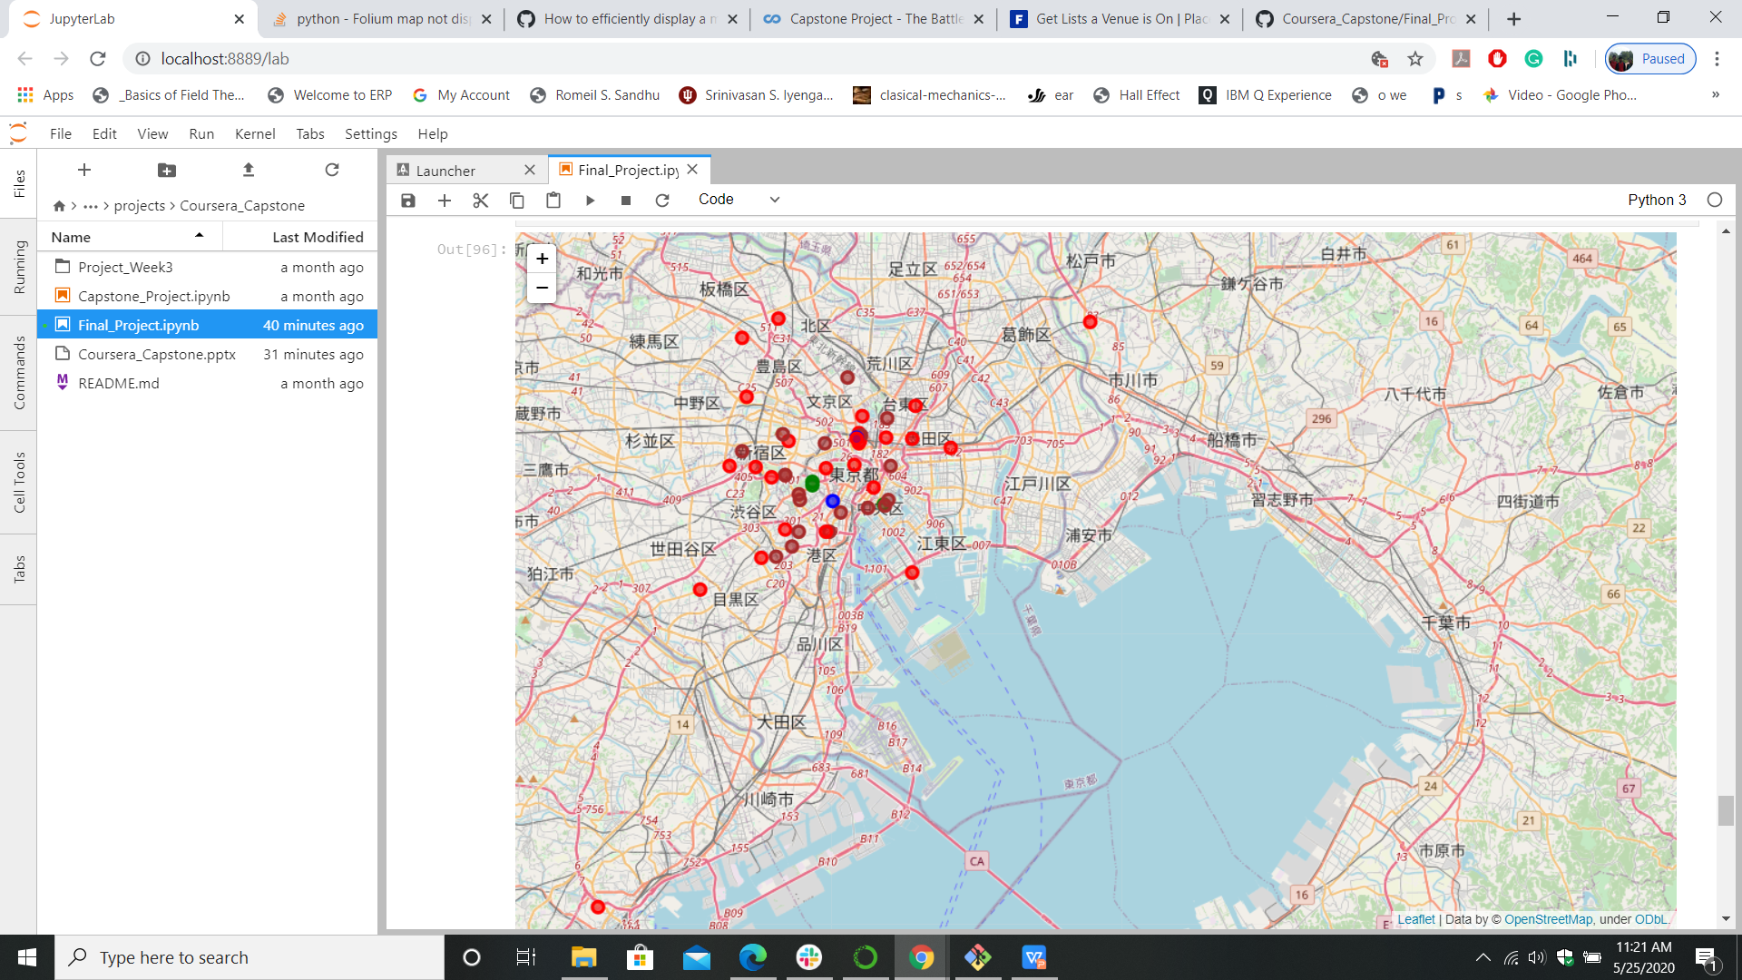
Clustered Tokyo

Slide 13
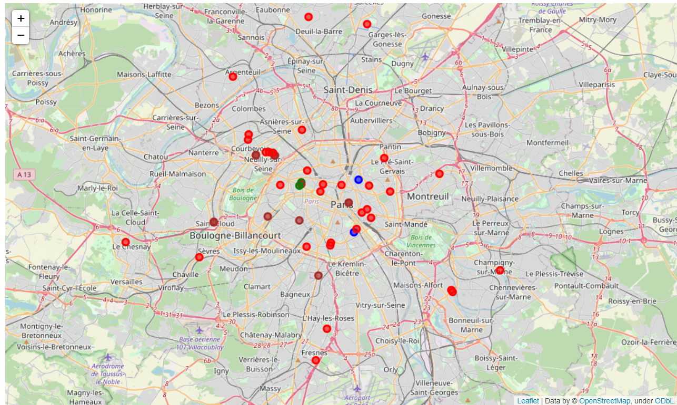
Clustered Paris

Slide 14
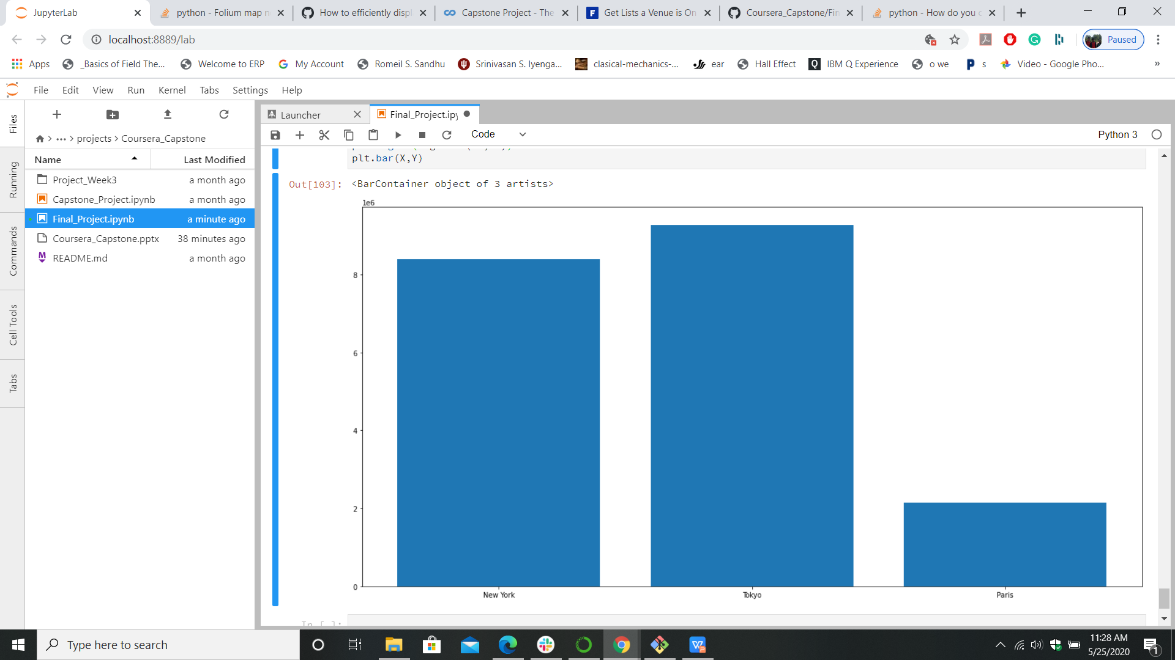
POPULATION sTATS

Slide 15
Results
New York is most distributed among them
Tokyo looks pretty connected but concertrated at a spot
Paris has a good picture of well distributed.
Population stat's reveal Tokyo is highly populated but the density of hospitals is also very high hence if worked together they can contain a pandemic
New York, it won't be easy for them as they are far and will take time to connect and transport
For Paris it's best relatively better connected and least populated with a benfit of centerd to connect easily

Slide 16
Conclusion
In case of a pandemic, a place with hospital and population stats of Paris will be better to connect and predict

